Slide 1


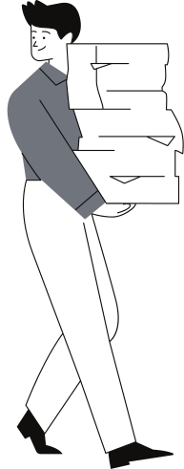

AIoT CEE Program, CityU
Eyesight
Protector
Project Number: P3
Students:
05 CHAN Chun Ting (Justin)
18 LAI Ching Fung (Sunny)
March 4, 2023

Slide 2
P3
March 4, 2023
1
Background and Existing Solutions
Today's
Content
2
Methodology
3
Functions
4
Results

Slide 3

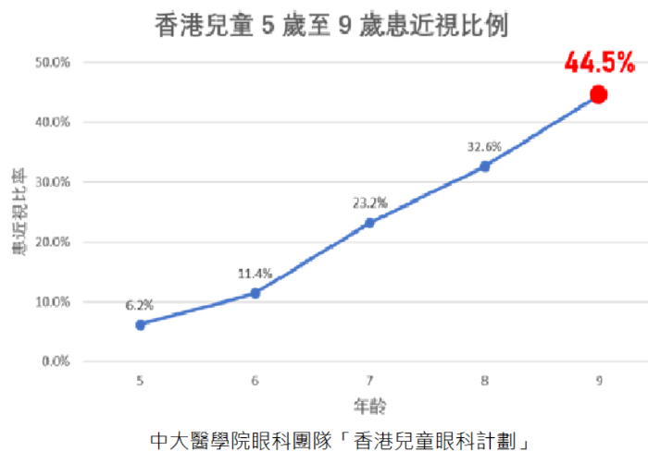
Background
Myopia is a very common issue among Hong Kong youngsters.
44.5% of 9-year-old Hong Kong children has myopia.
It proves that myopia is a serious problem to be solved in Hong Kong.

Slide 4
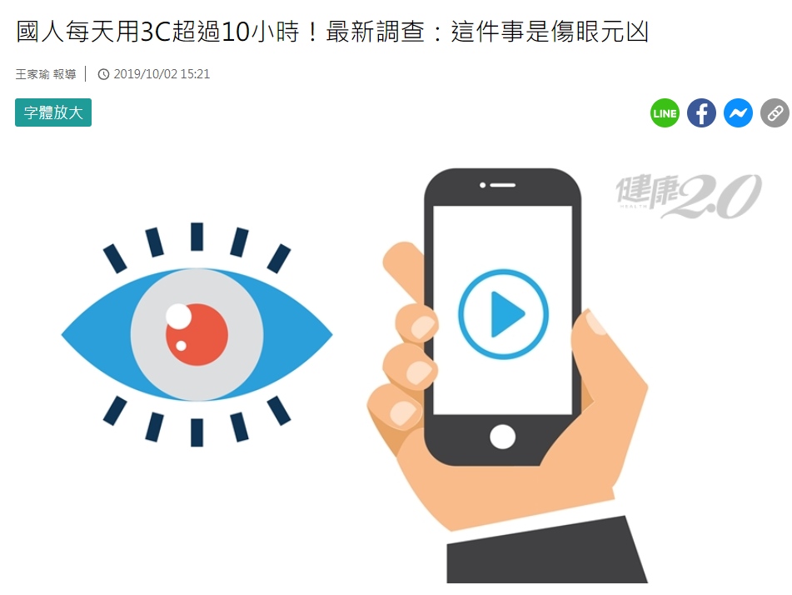
Background
Long term near work is a very common cause of myopia.
With electronic devices growing popularity, poor habits during usage of such devices is a main cause of myopia.
TVBS: Taiwanese uses electronic devices on average 10 hours per day

Slide 5
Targets
Remind users when they are too close to the screen
Remind users to rest
It is proven that long term near work is a cause of myopia.
Using computer for a long period of time causes sore eyes.
Maintaining a habit to keep distance is important.
Maintaining a habit to rest among users can solve the problem!

Slide 6
Existing Solutions
Parental control
Radar distance detector
Existing solutions generally focus on limiting usage time through parental control.
It uses radio wave to detect the distance. It is more accurate as it has a very low error rate.
Yet, these usage time monitors are unable to promote healthy habits during usage.
Although it is said to be more accurate, it is inconvenient to install it on a personal computer for daily use.

Slide 7
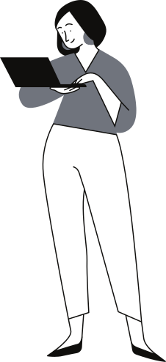
Our solution
Built-in camera as a solution.
We use built-in camera instead of the radar sensor to measure the distance. Although the accuracy has decreased a bit, it is proven to be a probable way with acceptable accuracy, while ensuring and keeping the convenience.

Slide 8
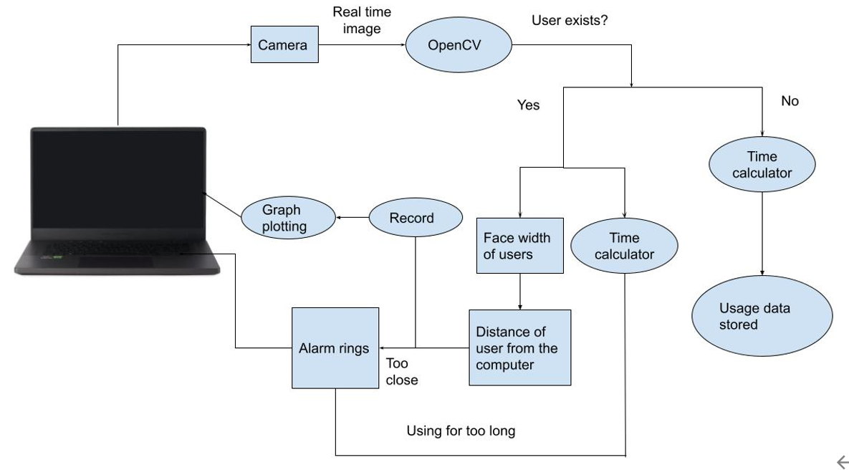
Methodology

Slide 9
Keeping things simple
Use with no extra devices
Only few data needed
Only your webcam is used, which is found on most laptop.
We only require 3 data from you:
Your face width
Your distance from the camera for calibration
The length of time of 1 period
Quick calibration
Calibration is usually done within 10 seconds. You can use the program as long as you can, hassle free, afterwards.

Slide 10
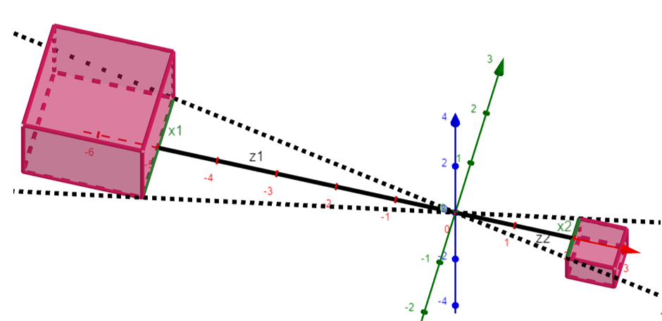
Simple Algorithm
We aim to find the distance of the user from camera using calibration data, as well as the user's face width.

Slide 11
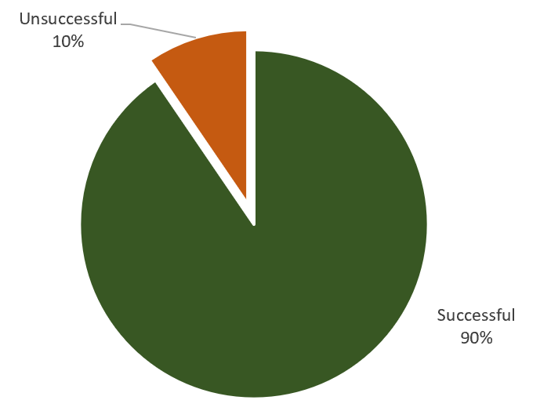
With passerby

Slide 12
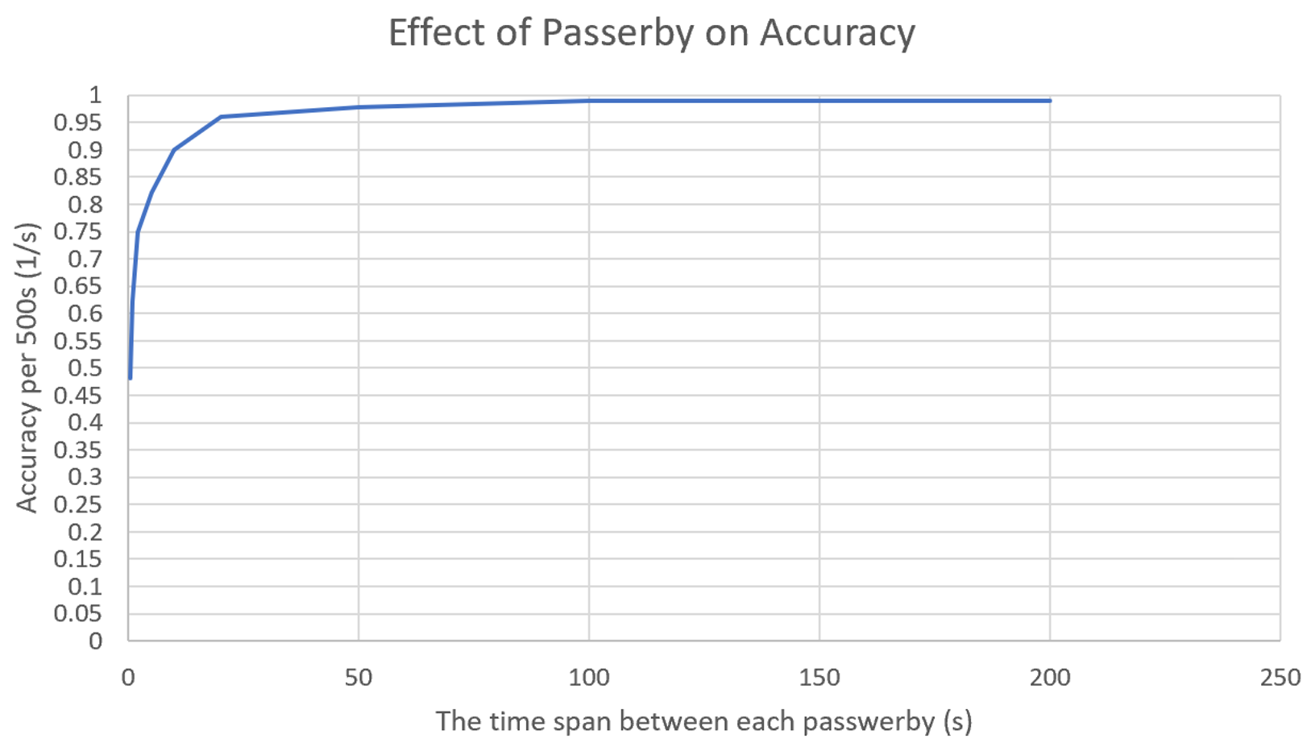

Slide 13
AI Recognition to help
At the calibration stage, a variable number of photos of the user are taken. It is used to generate a make-shift data base to determine whether a face captured by camera is the user.
Then, during operation, the program identifies the user and labels who is the user and who is an unknown stranger in the video feed.
Finally, the width of the user is used to determine his distance from the camera.

Slide 14
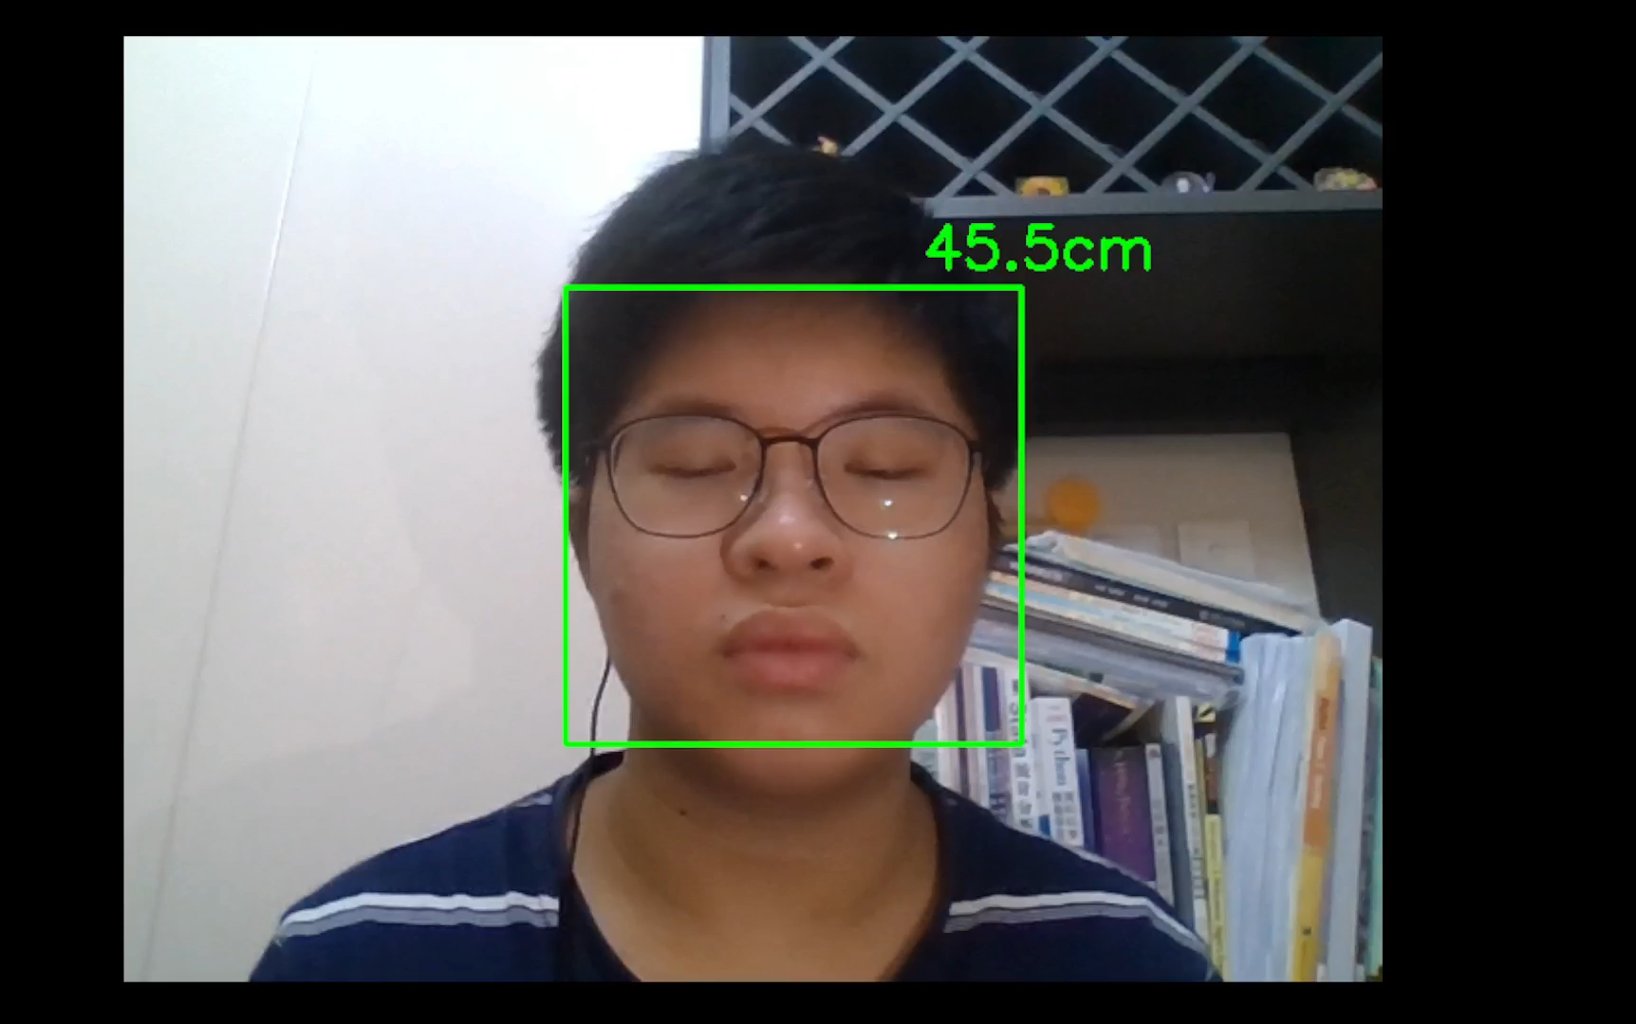
Simple Demonstration - Too close!

Slide 15
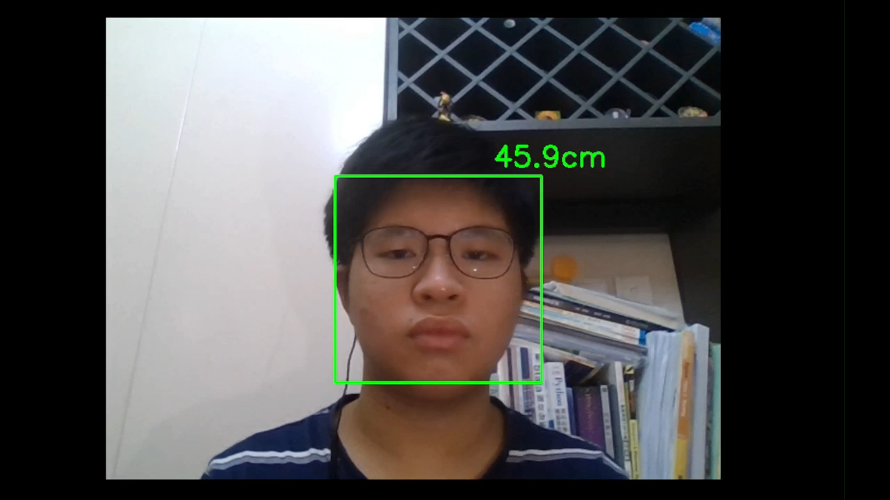
Simple Demonstration -
Using the computer for too long

Slide 16
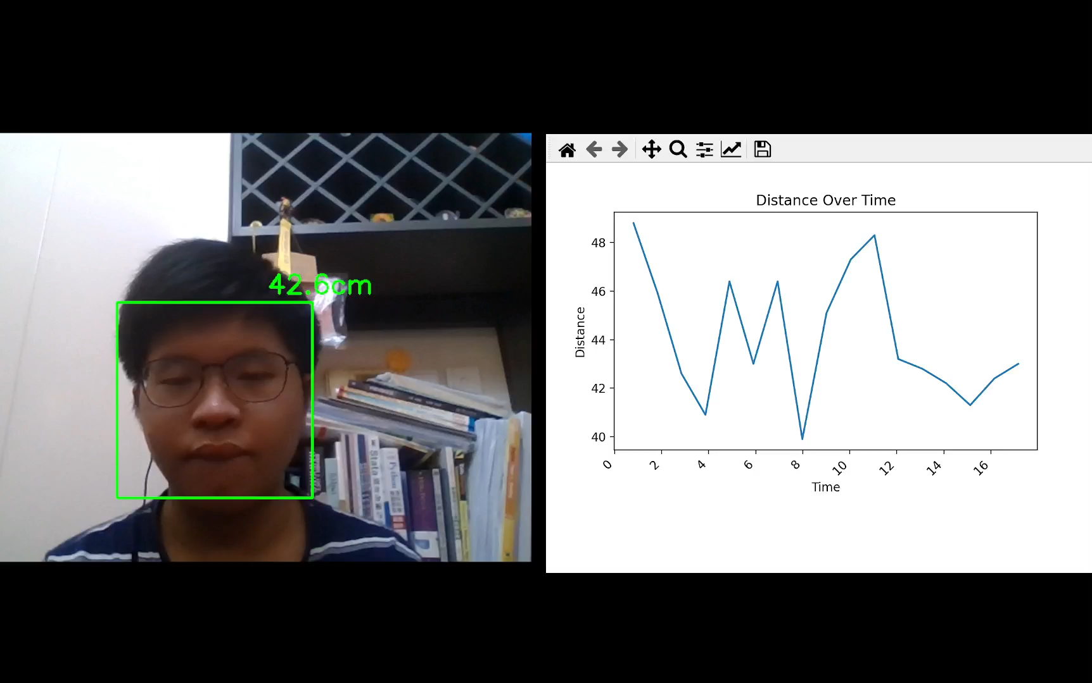
Simple Demonstration - Graph Function

Slide 17
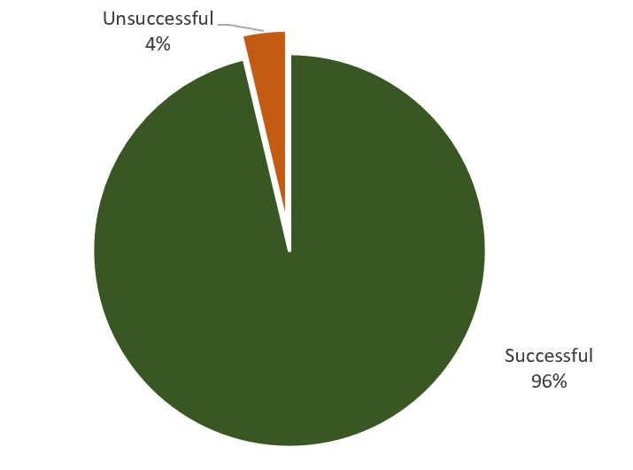
Percentage of time that a face is successful recognized
Results
3%
97%

Slide 18
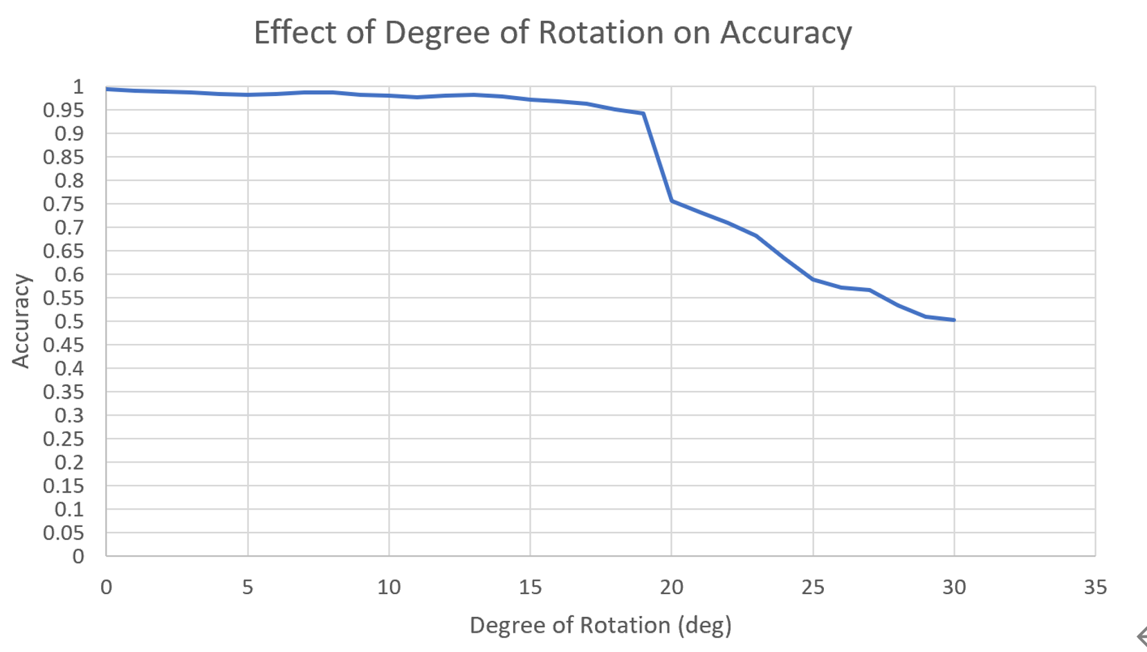

Slide 19
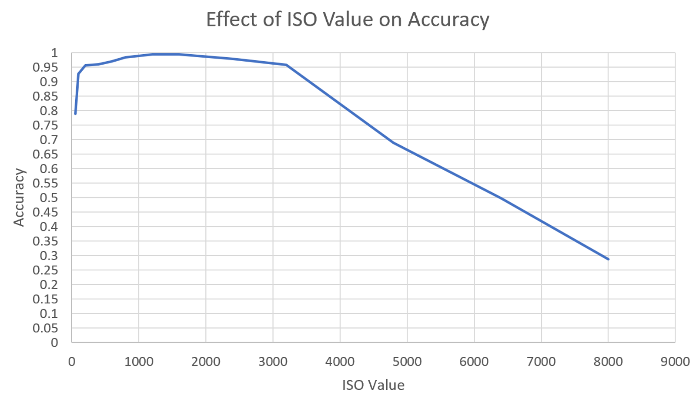

Slide 20
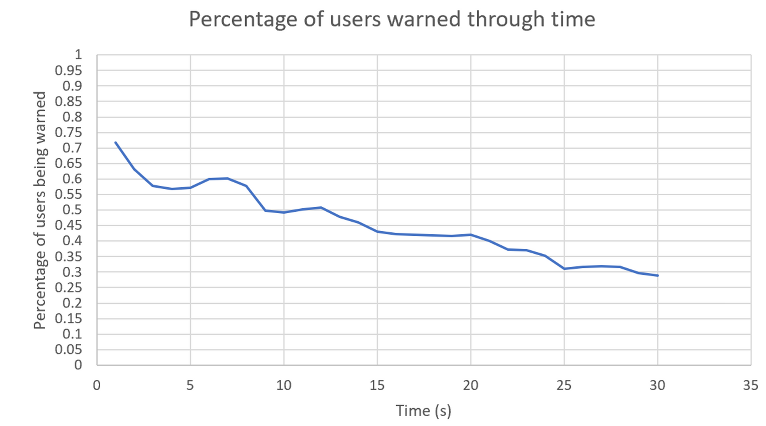
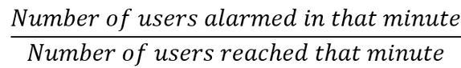
Number of users warned decreases over time!
Calculation of percentage

Slide 21
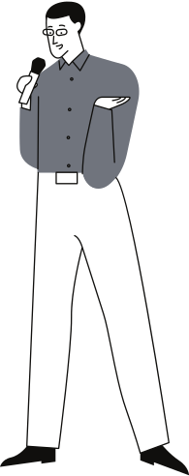
Limitations
More work makes perfect!
There are currently 2 main limitations which could be improved.
Lack of incentive for users to follow our instructions.
It could be tricked by photos.

Slide 22
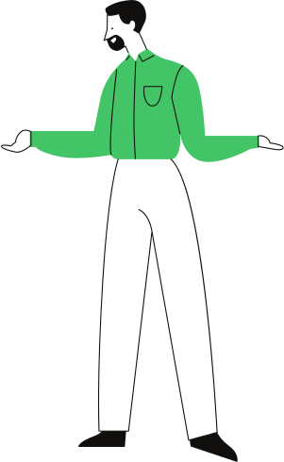
Thank you!
Thank you for participating. Have a great day ahead.

